Slide 1
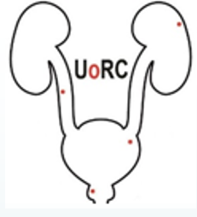
Management of Lower Urinary Tract Symptoms Caused by
Benign Prostatic Enlargement
By : Dr Mojtaba Haddad
Assistant professor of Urology
Tehran university of medical sciences

Slide 2
Patient's clinical characteristics
Findings of the baseline diagnostic assessment
Patient preferences
Conservative
Active management (medical or surgical treatment)

Slide 3
Conservative Management
Mild-to-moderate noncomplicated LUTS (AUA and EAU)
Watchful Waiting
Complicating factors:
Gross hematuria
UTIs
Elevated PSA level
Elevated PVR volume
Neurologic diseases

Slide 4
Watchful Waiting
Reassurance
Education of the patient
Lifestyle interventions
Periodic monitoring

Slide 5
Lifestyle and Dietary Modifications
Education and Reassurance
Fluid Management
Caffeine and Alcohol
Concurrent Medication
Types of Toileting and Bladder Retraining

Slide 6
Medical Therapy
Surgical treatment was the mainstay of treatment for patients with BPH-related LUTS until the 1990s
First-line treatment for patients bothered by LUTS
Without imperative indications for surgery (AUR, recurrent UTIs, renal insufficiency, bladder stones, and recurrent gross hematuria)

Slide 7
Medical Therapy
α-adrenergic blockers (α1-blockers)
5ARIs
Antimuscarinic drugs
Phosphodiesterase type 5 inhibitors (PDE5Is)
β3-agonists
plant extracts

Slide 8
patient's symptoms
Considering symptom severity, PV, PVR
Predominantly voiding symptoms :
α1-blockers, 5ARIs and PDE5Is
Predominant storage symptoms:
Muscarinic receptor antagonists or β3-agonists
complain of nocturnal polyuria:
Desmopressin

Slide 9
Assessment of Response to Medical Treatment: Outcome Measures
Objectify the effectiveness of a drug
Possible need to modify the therapy
Goals :
Relieving symptoms (AUASI or the IPSS)
Decreasing BOO (PFSs or uroflowmetry)
Improving bladder emptying (PVR volume)
Ameliorating DO (urodynamic study)
Reversing renal insufficiency
Preventing disease progression, defined as symptom deterioration and/or the occurrence of complications requiring surgical treatment

Slide 10
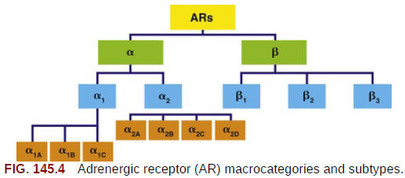
Therapy With α1-Adrenergic Blockers
First-line treatment of LUTS in men
α1a-ARs are mainly expressed in the liver, followed by the heart and the central nervous system; conversely
α1b-ARs are mainly expressed in blood vessels, spleen, and kidney
α1d-ARs are highly expressed in the cerebral cortex and the aorta
Treatment-emergent AEs associated with α1-blockers are caused by the effect of every drug on the vascular tissue, CNS, and urogenital system
Overall, dizziness, asthenia, hypotension, and anejaculation are the most commonly reported AEs according to RCTs

Slide 11
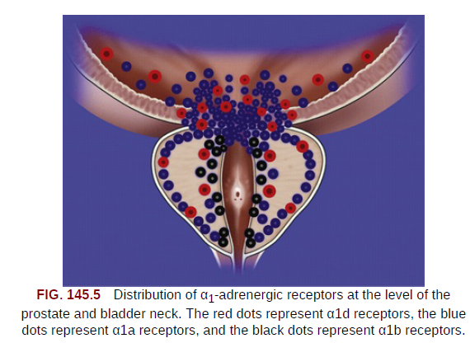
Overall, smooth muscle contraction is largely mediated by α1-Ars
Both in the prostate and urethra
α1a subtype accounts for 70% within the prostate
The blockade of α1-ARs leads to the relaxation
of smooth muscle tissue at both sites, with a decrease of the sympathetic baseline muscle tone and the consequent relief of symptoms

Slide 12
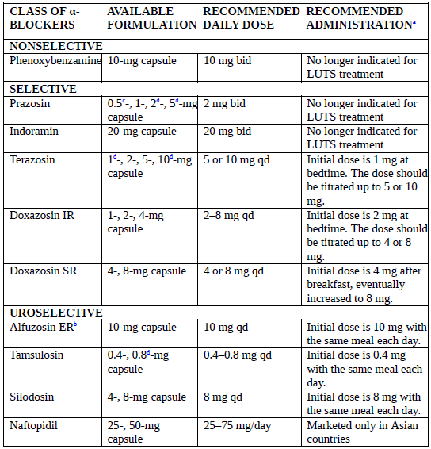

Slide 13
Because of the nonselectivity of the molecule, blocking both α1 and α2 receptor subtypes, serious cardiovascular AEs were observed, and the drug was no longer used to treat LUTS/BPH
Prazosin was the first selective α1-AR antagonist investigated for LUTS treatment , because of its short serum elimination half-life, prazosin requires administration at least twice daily
Doxazosin and terazosin were developed as selective α1-AR antagonists with a longer half-life, allowing a more user-friendly once-daily administration
Tamsulosin, alfuzosin, silodosin, and naftopidil are defined as uroselective drugs and have a higher affinity for the α1a and α1d receptor subtypes than for the α1b subtype

Slide 14
Terazosin
22.4% reduction in symptom score
Significant increase in PFRs and mean urinary flow rates
Dizziness and asthenia
Terazosin was not shown to reduce PV when compared with placebo
Dose titration is recommended to minimize the risk for first-dose hypotension and syncope
Patients should be counseled to start treatment with 1 mg terazosin taken at bedtime, further increasing up to 5 or 10 mg

Slide 15
Doxazosin
Symptom score decreased significantly by 39%
PFR increased by a mean of 2.9 mL/s
The significant impact of doxazosin on blood pressure
Need dose titration to avoid the risk for vascular-related AEs associated with first dosing
No significant changes in PV

Slide 16
Alfuzosin
High efficacy for relieving LUTS
Lower rate of cardiovascular Aes (postural hypotension, syncope, vertigo, and dizziness) or CNS Aes (somnolence, asthenia)
10 mg once-daily alfuzosin is an effective and safe compound with no need for dose titration
Alfuzosin should be taken after the same meal each day
Slightly greater impact on the cardiovascular system compared with tamsulosin among uroselective compounds

Slide 17
Tamsulosin
Tamsulosin is a uroselective α1-blocker with higher affinity for the α1a and α1d receptor subtypes
PFR increased within 4 to 8 hours after a single 0.4-mg dose, and symptom relief was evident after 1 week of treatment
Symptomatic relief was slightly greater with 0.8 mg tamsulosin compared with 0.4 mg tamsulosin
Tamsulosin is recommended at the dose of 0.4 mg taken after the same meal each day
Do not require dose titration

Slide 18
Silodosin
The highest selectivity for the α1a-AR subtype
Relief of both storage and voiding symptoms
Anejaculation was the most commonly reported AE, followed by dizziness, whereas orthostatic hypotension was rarely observed
Silodosin is recommended at the daily dose of 8 mg taken with a meal
No differences between silodosin and 0.4 mg tamsulosin

Slide 19
Naftopidil
The only compound developed with a distinct selectivity for the α1d-
AR subtype
Naftopidil was found to relieve storage symptoms (e.g., frequency, urgency, and nocturia) with a higher magnitude than low-dose tamsulosin
Dizziness and hypotension being the most commonly reported AEs

Slide 20
α1-Blockers and Sexual Function
Positive effects of α1- blockers on erectile function have been variably observed and ascribed to the beneficial effect of these drugs in terms of LUTS relief and QoL improvement
Ejaculation disorders

Slide 21
IFIS
Intraoperative floppy iris syndrome
During cataract surgery
Flutters and billows in response to normal intraoperative fluid movement
A prolapse of iris tissue toward surgical incisions
A progressive intraoperative miosis despite standard preoperative pupil dilation
Discontinuation of the use of drug before cataract surgery does not significantly reduce the risk for IFIS
No significant data have been reported regarding the occurrence of IFIS among patients treated with silodosin,

Slide 22
International clinical guidelines suggest α1-blockers as the first-line treatment in patients with bothersome moderate to severe LUTS
Patients should be counseled before treatment regarding the risk for sexual and vascular side effects associated with this therapy
Monitor blood pressure during the first week of treatment

Slide 23
Androgen Manipulation
Prostate tissue is androgen dependent, and both testosterone and dihydrotestosterone (DHT) play a key role in the development of BPH
Castration and pharmacologic agents suppressing testosterone and DHT synthesis or action are able to reduce PV in men with BPH
The first limitation of the androgen suppression hypothesis is that LUTS pathophysiology is not entirely dependent on prostate size

Slide 24
Classification of Pharmacologic Agents
GONADOTROPIN-RELEASING HORMONE ANALOGUES
PROGESTATIONAL AGENTS
ANTI ANDROGENS
5α-REDUCTASE INHIBITORS

Slide 25
Finasteride
Selective inhibitor of the type 2, 5α-reductase isozyme
Progressive decrease in PV :
After 12 months of treatment, the mean reduction in PV from the baseline was 19% in men treated with 5 mg finasteride
The most frequently observed AEs in the 5-mg group were decreased libido (4.7%) and ejaculatory disorders (4.4%)
51% reduction in the risk for either AUR or surgery for patients treated with finasteride
Finasteride reduced the incidence of diagnosed Pca (vs. placebo), although an increased incidence of high-grade disease was observed

Slide 26
Dutasteride
Dual inhibitor of 5α-reductase types 1 and 2
Greater decrease of serum DHT levels compared with finasteride
The most frequent AEs were erectile dysfunction and decreased libido, observed in 6% and 3.7% of patients
A long-term treatment (at least 6 months) is usually needed to observe a clinical benefit

Slide 27
Inhibitor of 5α-reductase
After 1 year of treatment, there was no difference in terms of symptom relief and PFR increase between patients treated with dutasteride and patients treated with finasteride ; similarly, the reduction of PV was comparable between the groups
International clinical guidelines suggest therapy with 5ARIs for patients with an enlarged prostate (>40 mL) and moderate to severe symptoms
long-term (≥6 months) treatment is required to observe a significant reduction of PV and a benefit in terms of symptom relief
Insulin resistance and diabetes, cardiovascular disease, and depression
Erectile dysfunction, decreased libido, or ejaculation disorders

Slide 28
Zanoterone (steroidal competitive androgen receptor antagonist)
Flutamide (nonsteroidal antiandrogen that inhibits the binding of testosterone and DHT to the androgen receptor)
Chlormadinone acetate (CMA) , (steroid antiandrogen that inhibits the uptake of testosterone by epithelial cells and the binding of DHT to the androgen receptor within the cell)
Aromatase Inhibitors (block the conversion of testosterone to Estrogens) Atamestane
Selective estrogen receptor modulators (SERMs) Tamoxifen, raloxifene, and toremifene

Slide 29
Cetrorelix
GnRH antagonist
Submaximal, noncastrating blockade of testosterone and DHT
Ability to titrate the level of androgen suppression
AEs (hot flashes, decreased libido, impotence)
The primary disadvantages of cetrorelix was the requirement for an injection and the cost

Slide 30
Muscarinic receptor antagonists
The mainstay of treatment for patients with OAB syndrome
Can be safely administered in patients with low PVR volume and no history of AUR
International clinical guidelines suggest the use of antimuscarinic therapy in patients with moderate to severe LUTS who mainly complain of bladder storage symptoms and present with a baseline PVR volume lower than 200 mL

Slide 31
β3-Agonist (Mirabegron)
Predominant form of β-ARs in the bladder
Increase in bladder capacity without a significant change in micturition pressure, PVR volume, and voiding contraction
Mirabegron is not recommended for patients with uncontrolled hypertension
International clinical guidelines suggest the use of mirabegron as an option for the treatment of patients with moderate to severe LUTS and prevalent storage symptoms
The recommended starting dose is 25 mg daily with or without food, which may be further increased to 50 mg

Slide 32
Phosphodiesterase Type 5 Inhibitors
Erectile dysfunction and LUTS are strongly correlated
Tadalafil has been the most widely assessed PDE5I in patients with LUTS
Tadalafil is currently the only officially licensed PDE5I for the treatment of male LUTS
International clinical guidelines currently suggest PDE5Is as an alternative therapy for men with moderate to severe LUTS, with or without associated erectile dysfunction
The recommended dose is 5 mg taken at approximately the same time every day with or without food

Slide 33
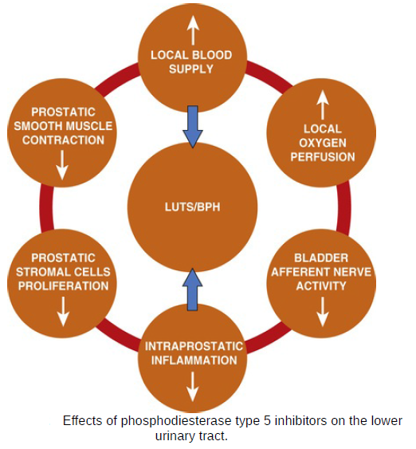

Slide 34
Combination Therapy
α-Adrenergic Blockers and 5α-Reductase Inhibitors
α-Adrenergic Blockers and Anticholinergic receptor Blockers
α-Adrenergic Blockers and β3-Agonists
α-Adrenergic Blockers and Phosphodiesterase Type 5 Inhibitors

Slide 35
Phytotherapy
Large and long-term trials did not report any difference between phytotherapy and placebo
Both European and American guidelines do not provide specific recommendations for the use of phytotherapy in treating patients with LUTS related to BPH
Serenoa repens is the most widely investigated phytotherapeutic agent for the treatment of LUTS and is recommended at a daily dose of 320 mg taken with food

