Slide 1
Geriatric Incontinence
S.R. Yahyazadeh M.D.

Slide 2
Prevalence:
A major problem for the elderly:
15-30% at home.
1/3 in acute care settings.
50% in nursing homes.

Slide 3
Is incontinence normal in elderly?
Abnormal at any age.
At no age affect the majority even over 85.
Relates more to age-associated diseases and functional impairments than to age itself.
Usually treatable and often curable at all ages.
The approach must differ significantly from younger patients.

Slide 4
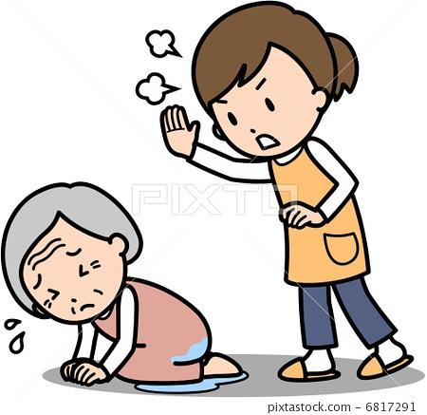
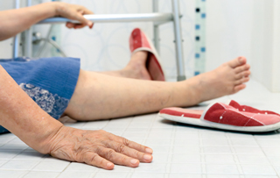
Drawbacks:
Perineal rashes
Pressure ulcers
UTI & urosepsis
Falls & fractures
Embarrassment
Stigmatization & isolation
Depression & anxiety
Sexual dysfunction
Risk of institutionalization

Slide 5
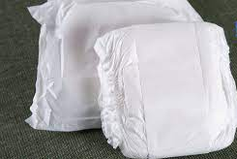
Transient Incontinence:
Delirium/confusional State
Infection
Atrophic urethritis/vaginitis
Pharmaceuticals
Excess urine output
Restricted mobility
Stool impaction

Slide 6
Pharmaceuticals
Sedatives/hypnotics
Anticholinergics, Antihistamines
Antipsychotics, Antidepressants
Narcotic analgesics
α-Adrenergic antagonists
Calcium channel blockers
Potent diuretics
NSAIDs
Anticonvulsants/analgesics
Parkinson agents
ACE inhibitors

Slide 7
Established Incontinence
Detrusor overactivity: the most common
Stress incontinence: the second most common
Urethral obstruction: in men
Isolated detrusor weakness: very uncommon
Impairment of cognitive or physical function

Slide 8
Successful treatment: a feasible but stepwise approach
Contributing medications, and diseases beyond the LUT
Behavioral therapy often works
bladder fullness, drinking less, voiding more often, coughing, and staying close to a toilet.
Medications, Surgery
Neuromodulation, Botulinum toxin

Slide 9
SUMMARY
Regardless of age, mobility, mentation, or institutionalization, incontinence is never normal.
Aging increases the likelihood of incontinence in the setting of additional physiologic, pharmacologic, or pathologic insults
Multifactorial, creative, persistent, and optimistic approach

Slide 10
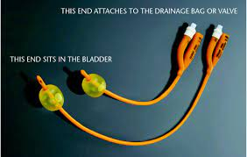
Principles of Catheter Care

Slide 11
Catheter Care
Maintain a sterile, closed gravity drainage system.
Secure to the upper thigh or abdomen.
Empty the bag every 8 hours.
Do not routinely irrigate the catheter.
Do not clamp or kink the drainage tubing.
Keep the bag below bladder level at all times.
Avoid frequent cleaning of the urethral meatus

Slide 12
Catheter Care
Periurethral antimicrobial creams: ineffective.
Adding disinfectants to the bag: ineffective.
Infection prophylaxis and treatment of asymptomatic bacteriuria are unnecessary and potentially misleading.

Slide 13
Catheter Care
“bypassing” in the absence of obstruction: bladder spasm.
symptomatic UTI: change the catheter before obtaining a culture specimen.
If frequent blockage persists, consider using a silicon catheter.

Slide 14
The best time to change
In the absence of obstruction and symptomatic UTI: no consensus on the best time to change
Some persons form a material that frequently clogs the lumen
Others can use a catheter for years, but it is customary to change it every 1 to 2 months.
For patients who are difficult to catheterize, the catheter can be changed less frequently.
For long-term need: silicone catheter

