Slide 1
Neurourology Anatomy, Physiology and Beyond
Erfan Amini M.D.
Assistant Professor of Urology
Tehran University of Medical Sciences

Slide 2
Anatomy

Slide 3
Anatomy
Afferent Sympathetic
Efferent Sympathetic (T11-L2)
Afferent Parasympathetic
Efferent Parasympathetic (S2-S4)
Afferent Pudendal
Efferent Pudendal (S2-S4)

Slide 4
Anatomy

Slide 5
Anatomy

Slide 6
Anatomy

Slide 7
Neurophysiology

Slide 8
Pathophysiology

Slide 9
Suprapontine Lesions

Slide 10
Sacral/Infra-sacral Lesions

Slide 11
Sacral/Infra-sacral Lesions
Overflow incontinence

Slide 12
Supra-Sacral/Infra-Pontine Lesions

Slide 13
Spra-Sacral/Infra-Pontine Lesions

Slide 14
Supra-Sacral/Infra-Pontine Lesions

Slide 17
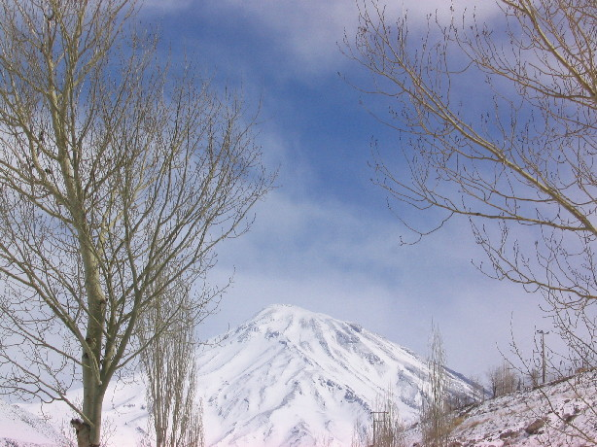
Thanks for Your Attention

