Slide 1
Low grade CIN young – pregnant women
SH-Sheikhhasani
GYN.Oncologist
Tehran University of Medical Sciences
12-5-1402

Slide 2
Initial approach to management of CIN is primarily based on :
the patient's risk for progression to cancer
also considers treatment-related morbidity and the compliance with a management plan

Slide 3
There are two general approaches:
●Close observation with (HPV) testing, cervical cytology, and/or colposcopy.
●Treatment :
excision or ablation of the cervical transformation zone(specialized cells that are thought to be susceptible to HPV infection and transformation.)
Hysterectomy is occasionally performed instead of excision or ablation but is unacceptable as a primary treatment for CIN in most instances.
Medical therapies have also been described

Slide 4
patient's risk for progression to cancer is related to age and CIN grade:
●Age
Patients younger than 25 years have a lower risk of developing cervical cancer than 25 years and older.
●CIN grade
CIN 1 is a low-grade lesion that has a low potential for progression to malignancy and a high potential for regression, CIN 2,3 is a high grade lesion that has a higher potential for progression and a lower potential for regression.

Slide 5
observation is the preferred approach for most younger patients and those with CIN 1

Slide 6
HPV vaccination status does not affect the approach and patients are managed similarly irrespective of HPV vaccination status

Slide 7
Effect of age
in 18 to 29 years , 61 percent of patients with a newly diagnosed, HR- HPV infection cleared the infection at 12 months of follow-up
low risk of cervical cancer in young patients
HPV regression
annual incidence of cervical cancer at ages 20 to 24 years 1.4 per 100,000 females
25 to 39 years was 5.9 to 14.2 per 100,000 females
all cases of CIN and cervical cancer are attributable to HPV infection
the rate of HPV infection is high in younger patient populations,
the infection and associated cervical intraepithelial lesions often regress spontaneously in this population

Slide 8
Natural history of CIN 1 – ( in mean age 29.2 years)
•At six months:
49 percent regressed to negative
35 percent had persistent CIN 1
7 percent had high-grade lesions
•Among patients with persistent CIN 1 at 6 months and followed to 12 months: 50 percent regressed to negative
46 percent had low-grade lesions
4 percent had high-grade lesions

Slide 9
CIN 1
Patients <25 Years

Slide 10
LSIL or less
CIN I
Preceded by
ASC-H or HSIL

Slide 11
Preceded by LSIL or less
Cytology should be performed in one year
cytology is (LSIL) or less (LSIL, ASC-US, [NILM])
cytology should be repeated in one year
NILM
ASC-US or greater
routine screening (with cytology when <25 years, and with HPV-based testing when ≥25 years)
colposcopy should be performed

Slide 12
Preceded by LSIL or less
Cytology should be performed in one year
ASC-H
HSIL
AGC
colposcopy should be performed

Slide 13
Preceded by ASC-H
observation consists of cytology alone in one and two years
OR
Review cytologic,histologic ,colposcopic finding
Preceded by HSIL
observation consists of colposcopy and cytology in one and two years

Slide 14
diagnostic excisional procedure
If during observation high-grade cytology (ASC-H or HSIL) persists for two years in the absence of a histologic HSIL, then a diagnostic excisional procedure is recommended
A diagnostic excisional procedure is recommended if the entire SCJ or lesion is not visible on colposcopy

Slide 15
MANAGEMENT OF PREINVASIVE DISEASE
IN PREGNANCY

Slide 16
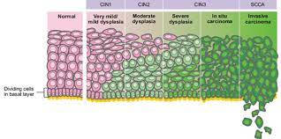
CIN in Pregnant patients
the risk of precancer is not known to be elevated among pregnant patients
The rate of progression of CIN to cervical cancer in pregnant patients is similar to that of nonpregnant patients.

Slide 17
Colposcopy?
Biopsy?
Endometrial curettage?
Endocervical curettage?
Conization?
Treatment?
Observation?

Slide 18
Women with abnormal cervical cytology in pregnancy
management is the same as nonpregnant women,
with the following exceptions:
Expedited treatment with a diagnostic excisional procedure is unacceptable without having first performed colposcopy.
Endocervical curettage and endometrial biopsy should not be performed as part of the colposcopic evaluation
the endocervical canal may be sampled gently with a cytobrush.

Slide 19
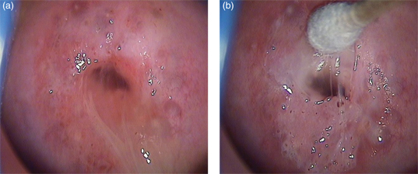
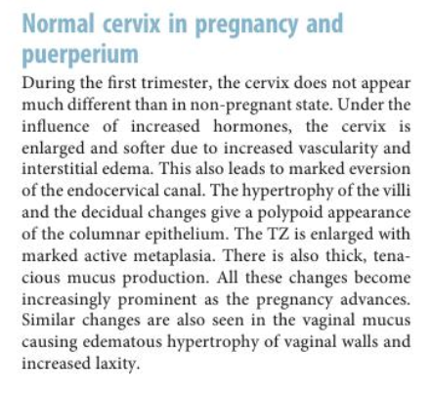
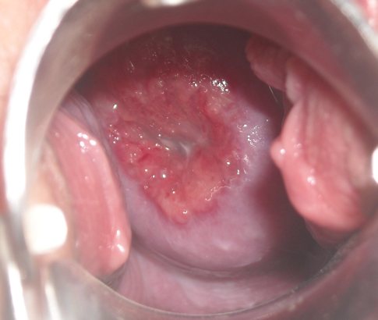

Slide 20
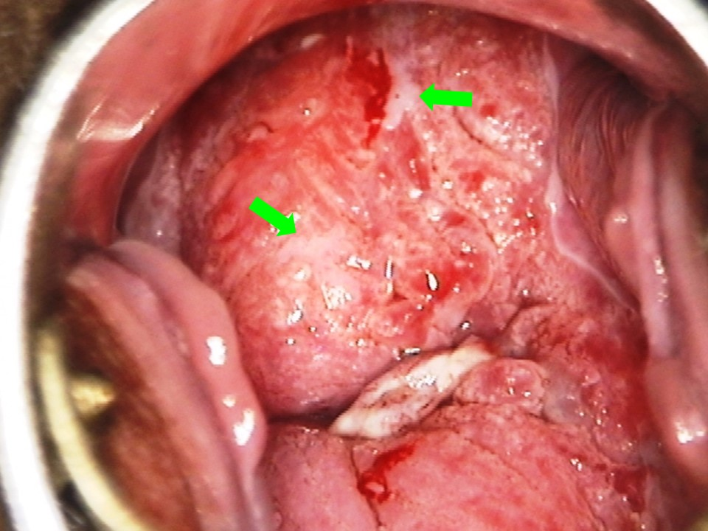
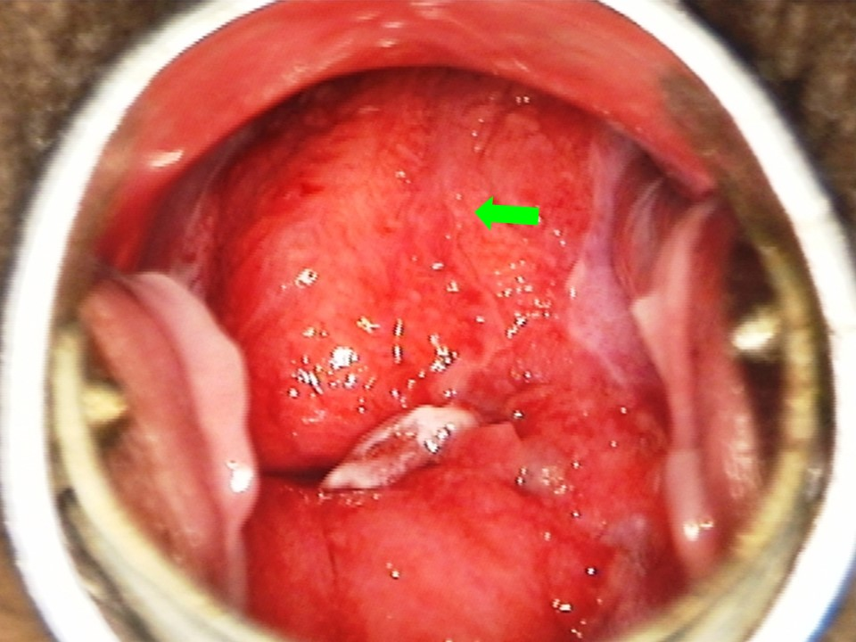

Slide 21
Colposcopy
Colposcopic evaluation of the cervix in pregnancy is challenging
it should be done by a colposcopist experienced in recognizing both pregnancy-related and cancer-related cervical changes.
Colposcopist experience, specifically in the evaluation of the pregnant patient, is known to affect the ability to visually distinguish cancers from pregnancy-related changes, decrease the risk of a missed cancer diagnosis.
it should be done by a colposcopist experienced in recognizing both pregnancy-related and cancer-related cervical changes.

Slide 22
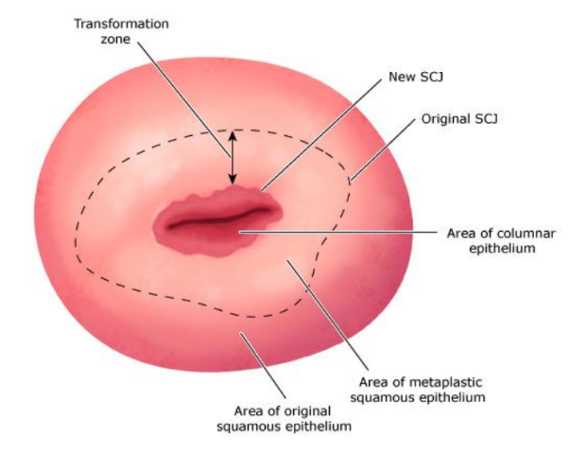
Colposcopy: Evaluation of the transformation zone
If colposcopy in early pregnancy is unsatisfactory, repeating the procedure in 6 to 12 weeks may result in a satisfactory examination
because the transformation zone may have "migrated" to the ectocervix, thus allowing a satisfactory examination by 20 weeks of gestation.

Slide 23
Colposcopy: Cervical biopsies
colposcopydirected biopsies in pregnant patients seem to be safe
can be performed during pregnancy without a significantly increased risk of excessive bleeding.
Bleeding, if encountered after biopsy, can be controlled with use of Monsel solution or suturing.
Endocervical curettage is not performed in pregnant women because of concern that it may disrupt the pregnancy, although there is no evidence proving an increased risk of pregnancy disruption

Slide 24
Even when the preinvasive disease is high-grade, the risk of progression to invasive carcinoma during pregnancy is exceedingly small (0 to 0.4 percent).
regression may occur postpartum, thus obviating the need for excision.
Treatment of preinvasive disease should be deferred to the postpartum period.
Re-evaluation and definitive therapy for preinvasive disease should be completed six to eight weeks following delivery
Most of experts do not advocate excision during pregnancy because it can be a morbid procedure

Slide 25
Pregnant patients with CIN 1
should not undergo cervical excision or ablation, regardless of the duration of the abnormality and irrespective of whether the preceding tests were high grade ( [HSIL] or [ASC-H]).
The patient should be reevaluated four weeks postpartum and managed based on those results.

Slide 26
Treatment of CIN 2 or 3 in Pregnant patients??
Treatment of CIN 2 or 3 is not recommended
in whom invasive disease is not suspected

Slide 27
Pregnant patients with CIN 2 or 3
in whom invasive disease is not suspected are managed accordingly:

Slide 28
Repeated biopsy: only if the appearance of the lesion worsens or if cytology suggests invasive disease
With: colposcopy and cytology ( [HPV] if age appropriate)
preferred
. Endocervical sampling with a curette and endometrial sampling should not be performed as there is a risk of disturbing the pregnancy.
When: every 12 to 24 weeks during the pregnancy
acceptable
Deferring colposcopy until four weeks postpartum

Slide 29

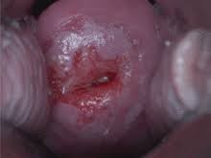
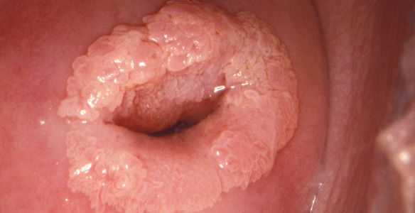
Invasive disease suspected
A diagnostic excisional procedure is performed only if invasive disease is suspected.

Slide 30
In the postpartum period:
colposcopy is recommended no earlier than 4 weeks after delivery (BII).

Slide 31
In the postpartum period:
colposcopy is recommended no earlier than 4 weeks after delivery (BII).
In patients diagnosed with histologic HSIL (CIN2 or CIN3) during pregnancy:
an excisional treatment procedure or
full diagnostic evaluation (cervical cytology, HPV, and biopsy) is acceptable (BII)
if a lesion is detected at postpartum colposcopy
In the absence of a lesion on colposcopy
a full diagnostic evaluation is recommended;
expedited treatment is not recommended (BII)

Slide 32
Indications for and performance of conization
conization in nonpregnant patients:
Diagnosis: to exclude invasive cancer when a punch biopsy shows only microinvasive disease or adenocarcinoma in situ( to identify maximum depth of invasion )
Treatment: high grade CIN
Traditional indications for cervical conization in the nongravid population are not applicable during pregnancy.
the morbidity associated with cervical conization during pregnancy is substantial

Slide 33
Indications for and performance of conization
conization is postponed until the postpartum period to avoid potentially disrupting the pregnancy
diagnostic conization is only indicated during pregnancy if confirmation of invasive disease will alter the timing or mode of delivery

Slide 34
Potential complications of conization during pregnancy include:
hemorrhage (5 to 15 percent)
miscarriage
premature rupture of membranes
preterm labor/delivery
infection
Fetal death is uncommon. It has been reported weeks after the conization procedure and, in some cases, was attributed to chorioamnionitis.

Slide 35
Considerations about delivery
It is unclear whether route of delivery (vaginal versus cesarean) affects the rate of regression; route of delivery should be based on standard obstetrical indications.
Retrospective and case-controlled studies suggest that vaginal delivery through a cervix with microscopic cervical cancer generally does not alter maternal prognosis.
Therefore, women with stage IA1 and IA2 cervical cancer can proceed with a vaginal delivery, with cesarean delivery reserved for standard obstetrical indications.
Episiotomy should be avoided when possible.

Slide 36
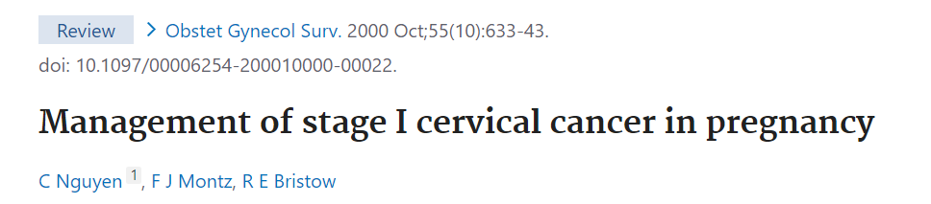
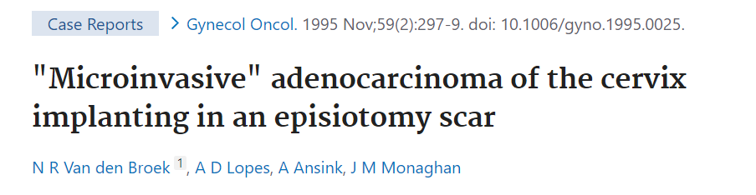
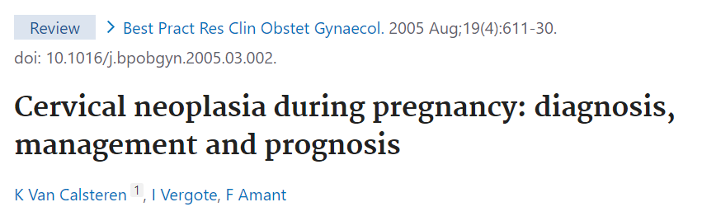
At least 15 cases of tumor cell implantation in the episiotomy site have been reported after vaginal birth in women with cervical cancer. Five of the 11 patients who had recurrence of cervical cancer in the episiotomy site died of their disease

Slide 37
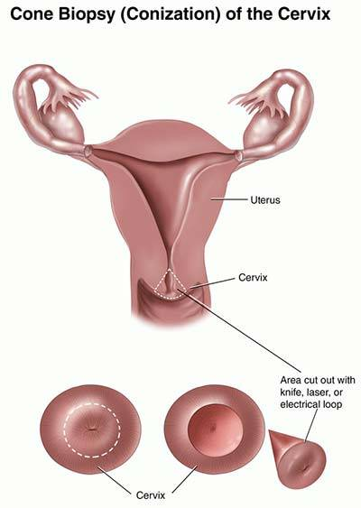
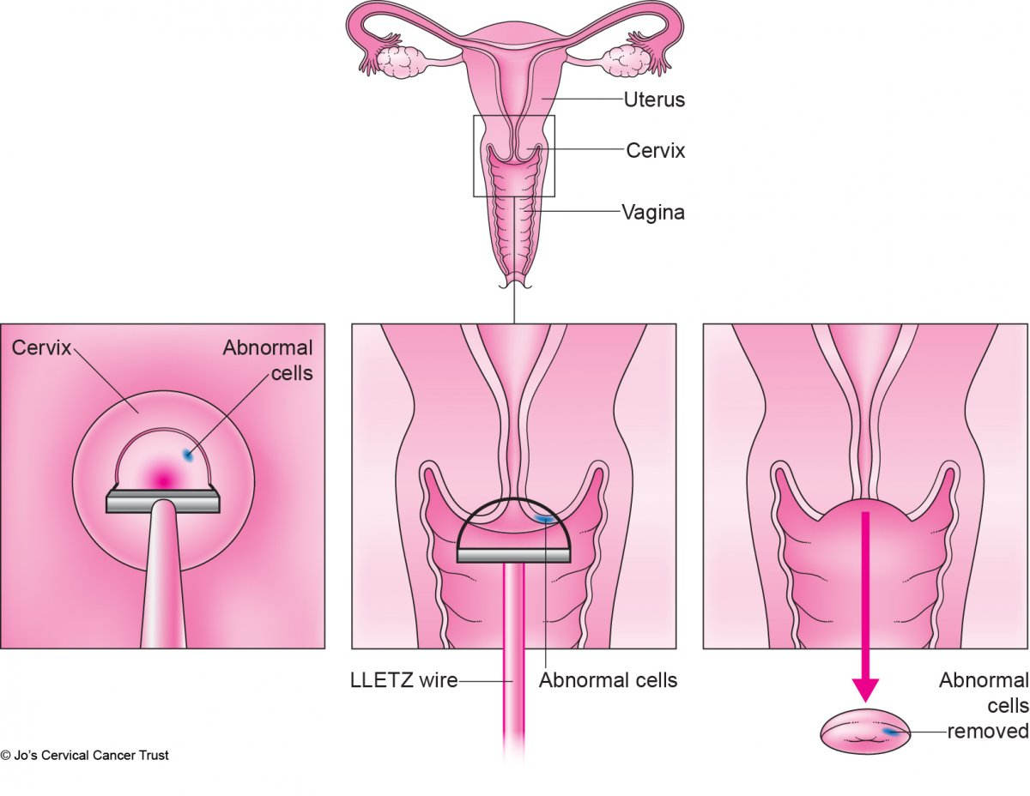
It is suggested excising a "coin"-shaped specimen instead of a "cone"- shaped specimen to:
limit disruption of the endocervical canal, minimize morbidities associated with blood loss, avoid disturbing the fetal membranes.
If a true conization is required, one option is to perform a cone cerclage whereby a cerclage is placed immediately after the conization
coin-shaped

Slide 38


