Slide 1
HSIL
Dr.Arezoo esmailzadeh, fellowship of gynecology oncology Baqiyatallah University of Medical Sciences, Tehran, Iran

Slide 2
INTRODUCTION
Cervical intraepithelial neoplasia (CIN) is a premalignant lesion of the uterine cervix that is classified as low grade (CIN 1) or high grade (CIN 2,3) based on the risk of progression to malignancy

Slide 3
risk for progression to cancer
Effect of age :The low risk of cervical cancer in young patients is supported by data from the United States (1999 to 2008) showing that the annual incidence of cervical cancer at ages 20 to 24 years and 25 to 39 years was 1.4/100,000 women and 5.9 to 14.2/100,000 women, respectively . in a cohort study of 2065 patients 18 to 29 years of age, 61 percent of patients with a newly diagnosed, high-risk HPV infection cleared the infection at 12 months of follow-up

Slide 4
risk for progression to cancer Natural history of CIN 1
Among patients with negative results at 6 months and followed to 12 months, 80 percent remained negative, 16 percent had low-grade lesions, and 4 percent had high-grade lesions.
Among patients with persistent CIN 1 at 6 months and followed to 12 months, 50 percent regressed to negative, 46 percent had low-grade lesions, and 4 percent had highgrade lesions.
At six months, 49 percent regressed to negative, 35 percent had persistent CIN 1, and 7 percent had high-grade lesions.•

Slide 5
risk for progression to cancer Natural history of CIN 2,3
For CIN 3, the estimated spontaneous regression rate is 32 to 47 percent, with 12 to 40 percent progressing to invasive cancer if untreated .
For CIN 2, it appears that approximately one-half of patients will have regression if left untreated .
One explanation for the lower rate of progression of CIN 2 compared with CIN 3 is that CIN 2 is more likely to be caused by oncogenic HPV subtypes 31, 33, 35, 39, 45, 51, 52, and 58, which have a weaker association with development of cancer than the more highly oncogenic subtypes HPV 16 and 18, which are commonly found with CIN 3

Slide 6
MANAGEMENT OF PATIENTS ≥25 CIN 2
When treatment is planned, a diagnostic excisional procedure (LEEP, cold knife cone, and laser cone biopsy) is preferred. An ablation (with cryotherapy, laser ablation, and thermoablation) is an acceptable alternative
CIN 2,3 — High-grade CIN is also more likely to regress in younger patients than in older patients and is less likely to progress to cancer

Slide 7
PATIENTS ≥25 CIN 2
When observation is performed:
If histologic HSIL is unspecified (reported as histologic HSIL or HSIL [CIN 2,3] without distinction of CIN 2 or CIN 3):● Treatment is preferred; in these patients, CIN 3 cannot be excluded, and, therefore, patients are managed as if CIN 3 were present.
• Observation (with colposcopy and HPV testing at 6 and 12 months) is acceptable.
• If CIN 2 is specified:● Treatment is recommended.
• Observation (with colposcopy and HPV testing at 6 and 12 months for up to two years) is acceptable if all of the following are present

Slide 8
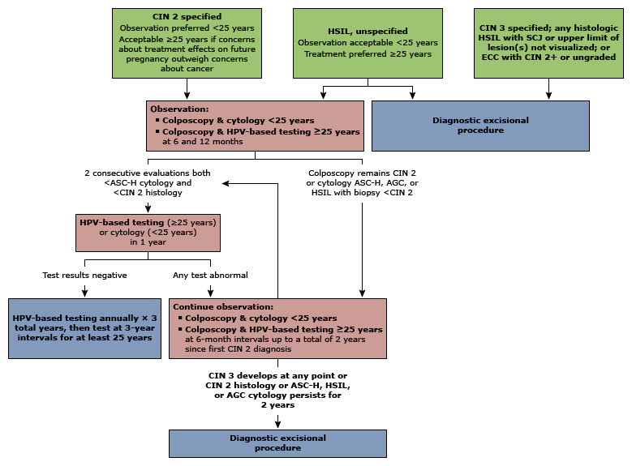

Slide 9
MANAGEMENT OF PATIENTS <25 YEARS
If histologic HSIL is unspecified (reported as histologic HSIL or HSIL [CIN 2,3]):● Observation or treatment is acceptable.• If CIN 2 is specified:● Observation is preferred.• Treatment is an acceptable option.
• If CIN 3 is specified or if the entire SCJ or lesion is not visible on colposcopy:● Treatment is recommended.• Observation is unacceptable

Slide 11
P16
P16 possetive supports the diagnosis of histologic HSIL if the morphological assessment of H&E slides is consistent with CIN2 OR CIN3.

Slide 12
CIN3
If CIN 3 is specified,
if the entire SCJ or lesion are not visible on colposcopy,
or if the ECC is CIN 2+:
● Treatment is recommended.
• Observation is unacceptable.•

Slide 13
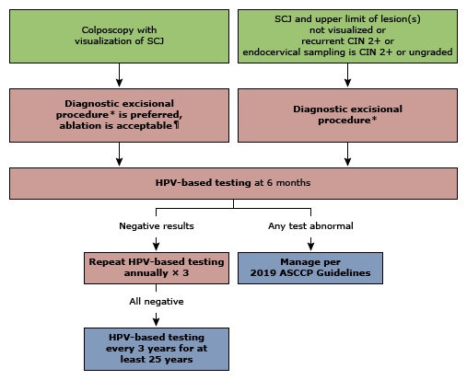

Slide 14
Pregnant patients
Observation with colposcopy and cytology (with human papillomavirus [HPV] if age appropriate) every 12 to 24 weeks during the pregnancy is preferred. A biopsy may be repeated only if the appearance of the lesion worsens or if cytology suggests invasive disease. Endocervical sampling with a curette and endometrial sampling should not be performed as there is a risk of disturbing the pregnancy.
•
Deferring colposcopy until four weeks postpartum is an acceptable alternative.• Treatment of CIN 2 or 3 is not recommended
Invasive disease suspected – A diagnostic excisional procedure is performed only if invasive disease is suspected

Slide 15
Patients with compliance issues
Immediate or "expedited" treatment can be used for nonpregnant patients with high-grade cytology who are unlikely to compelet with a management plan or who do not follow up promptly after abnormal cervical cytology results

Slide 16
Factors to consider in choosing excision versus ablation
By comparison, the American Society for Colposcopy and Cervical Pathology states that excision or ablation is acceptable treatment for CIN 1 (when treatment is indicated) but prefers excision over ablation for CIN 2,3.

Slide 17
Is a diagnostic specimen needed?
A lesion extends into the cervical canal and cannot be fully visualized
● A lesion covers >75 percent of the ectocervix or is beyond the reach of the cryoablation tip
● The endocervical curettage demonstrates CIN 2+ (or CIN that cannot be graded)
● The patient has had a previous excision for CIN 2+
● Glandular disease (including adenocarcinoma in situ [AIS]) is present
There is diagnostic uncertainty

Slide 18
Is excision more effective than ablation?
A 2013 meta-analysis of five randomized trials, including two trials also included in the 2018 meta-analysis, compared patients with CIN (all grades) treated with an excisional method versus an ablative method, and found that there were insufficient data to conclude that one method was superior for the treatment of CIN

Slide 19
Is future pregnancy planned?
Patients planning a future pregnancy may choose to avoid excision because it has been associated with an increased risk of adverse obstetric outcomes (second-trimester pregnancy loss, preterm pre labor rupture of membranes, preterm delivery) in large observational studies. Ablation, in theory, has a lower risk of adverse obstetric outcomes given that the cervix is better preserved than with excision

Slide 20
Comparison Excision & Ablation
Excision – Intra operative bleeding, infection, and delayed hemorrhage (usually one to two weeks postoperatively).
Ablation – Post treatment bleeding and infection; a prolonged, heavy, watery vaginal discharge can occur after cryotherapy

Slide 21
Potential candidates for hysterectomy
CIN 2,3 and positive excisional margins who have completed childbearing and in whom an additional excisional procedure cannot be performed
● Recurrent or persistent CIN 2,3 who have completed childbearing and in whom a repeat excisional procedure is not feasible or desired.
● Scarring or shortening of the cervix from prior treatments that prohibits a repeat excisional procedure. Scarring may increase the risk of complications of a repeat excisional procedure or limit the results of further testing
● Unwillingness or inability to comply with long-term follow-up

Slide 22
radical hysterectomy
If invasive disease is suspected, a diagnostic excisional procedure may be performed and sent for frozen section prior to hysterectomy to confirm that cervical cancer is not present and that a radical hysterectomy is not indicated

Slide 23
Poor prognostic factors
Positive margin status
● Human papillomavirus (HPV) DNA positivity, especially with HPV 16, six months or more post treatment
● Large lesion size (eg, greater than two-thirds of the surface of the cervix)
● Endocervical gland involvement

Slide 24
Prognosis by margin status
Negative margins — CIN appears to have a high rate of cure when the entire lesion has been excised, but few long-term studies are available. In one study of over 4400 patients with negative margins after an excisional procedure for CIN 3, a new high-grade cytologic or histologic lesion developed in only 0.35 percent of patients after a median of 8.9 years (range 3.3 to 16.8 years) . Positive margins — Studies have consistently shown that patients with positive margins after an excisional procedure, compared with negative margins, are at significantly higher risk for residual or recurrent disease. Recurrence can occur years after treatment; the mean time to recurrence was almost four years in one study

Slide 25
Prognosis when the entire excisional specimen is negative
A completely negative excisional specimen raises concern that the lesion was missed, and, therefore, these patients should be followed similarly to those with positive margins.

Slide 26
Prognosis when HPV is positive on follow-up testing
HPV status following treatment also appears to predict risk of recurrence, and HPV-based testing is now the primary followup testing technique after treatment for CIN
n a meta-analysis of 128 studies, HPV status was more effective than positive margins in predicting recurrence; the sensitivity and specificity to predict subsequent CIN 2+ were: margin status (56 and 84 percent), high-risk HPV status (91 and 84 percent), and combination of both margin and HPV status (99 and 58 percent) Absolute CIN 2+ risks associated with each measure were: negative margins (0.8 percent), positive margins (17 percent), HPV-negative (0.8 percent), and HPV-positive

Slide 27
Patients with CIN (all grades) treated with ablation or excision (and with negative margins)
For patients ≥25 years (algorithm 1) – HPV-based testing at six months; cervical cytology is acceptable only if HPV-based testing is not available.• If HPV is positive, then colposcopy and biopsies should be performed and managed based on these results.If HPV is negative, then HPV-based testing should occur annually for three years.If HPV remains negative, then HPV-based testing can occur every three years for at least 25 years

Slide 28
For patients <25 years – Cervical cytology at six months
If cervical cytology is high-grade squamous intraepithelial lesion (HSIL) or atypical squamous cells cannot exclude HSIL (ASC-H), then colposcopy with biopsies should be performed and managed based on these results.
f cervical cytology is low-grade squamous intraepithelial lesion (LSIL) or less (LSIL, HPV-positive atypical squamous cells of undetermined significance [ASC-US]) and persists, then colposcopy with biopsies should be performed and managed based on these results.
If cytology is negative, then cytology should occur at six-month intervals for three years.If cytology remains negative, then cytology can occur annually. When the patient reaches the age of 25, testing can transition to the HPV-based model and occur every three years, as above

Slide 29
Patients with CIN 2,3 treated with excision (and with margins and/or endocervical curettage [ECC] that is positive for CIN 2+)
For patients <25 years or those ≥25 years in whom there is concern about the potential effect of treatment on future pregnancy outcomes, observation (with HPV-based testing in six months [preferred] or colposcopy plus ECC at six months) is recommended.
If HPV is negative, then HPV-based testing should occur annually for three years. If testing remains negative, then HPV-based testing can occur every three years for at least 25 years.
If HPV is positive, then colposcopy and targeted biopsies should be performed and managed based on these results.If CIN 2+ continues, repeat excision should be performed.If repeat excision is not feasible or desired, hysterectomy is recommended.For patients ≥25 years and in whom future pregnancy and potential obstetric outcomes are not a primary concern, repeat excision or observation (with HPV-based testing [preferred] or colposcopy plus ECC at six months) are acceptable.
•

Slide 30
If hysterectomy is performed, management is as follows
Patients with CIN 2,3 on hysterectomy specimen or patients who underwent a hysterectomy for a history of CIN 2,3 have an increased risk of disease recurrence and should be followed with:
HPV-based testing annually for three years.If HPV is positive, cytology should be performed. Interpretation and management of vaginal cytology results are discussed separately. If HPV is negative for three consecutive years, long-term follow-up with HPV-based testing at three-year intervals is performed for 25 years.Patients with CIN 1 or less on the hysterectomy specimen and no history of CIN 2+ can discontinue follow-up testing

Slide 31
THANKS

