Slide 1
Dr.f.hadavi
Infertility Fellowship Assistant, University of Tehran

Slide 2
LUTEAL FUNCTION IN ART Physiology of Corpus luteum function
The hormonal activity of Corpus luteum is tightly controlled by the pulsatile production of LH by the anterior pituitary.
During the mid-luteal phase of the menstrual cycle, the daily production of progesterone is of approximately 25 mg/24 hours.
reported the results of serial (every 10 minutes) blood sampling (2): pulsatile LH secretion (one pulse approximately every 3 hours) is tightly accompanied by a progesterone pulse.
Based on these data, the through levels (in between pulses) are of approximately 5 ng/mL

Slide 3
Disruption of Corpus luteum in ART
In ART, the factors interfering with the normal support of CL function by the anterior pituitary include notably:
• Gonadotropin-releasing hormone (GnRH) analogs, agonists, and antagonists
• Excessive levels of E2 induced by COS
• The replacement of the LH surge by a triggering dose of hCG The net result of these effects is an insufficient production of progesterone by the CL, which compromises embryo implantation and development.
There is now overwhelming evidence that ART outcomes—pregnancy rates and live birth rates—are improved by luteal-phase support (LPS) .

Slide 4
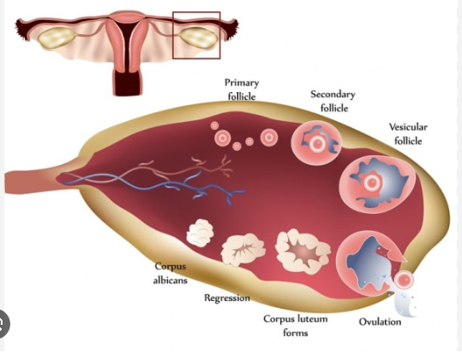
LPS can be accomplished by either an intermittent administration of
hCG or
sustained (daily) progesterone replacement.

Slide 5
PROGESTERONE ADMINISTRATION
Parentral
vaginal
oral
transdermic
first described
poor bioavailability
poor permeability

Slide 6
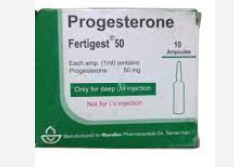
PROGESTERONE ADMINISTRATION Injectable preparations

Slide 7
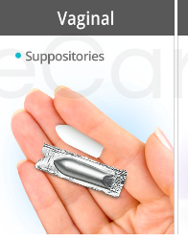
Vaginal progesterone

Slide 8
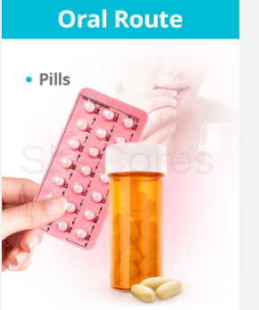
Impossible oral and transdermal progesterone

Slide 9
transdermal

Slide 10
New subcutaneous progesterone preparation

Slide 11
DURATION OF PROGESTERONE TREATMENT Onset of treatment
There is now a general consensus for favoring an early onset of LPS in ART on the evening of oocyte retrieval or the day after.
This is in part motivated by the fact that the uterus-relaxing properties of progesterone tend to reduce uterine contractions (UCs) at the time of ET .

Slide 12
Termination of treatment
Later, it is indeed the hCG produced by the developing embryo, not the anterior pituitary, that sustains proper CL function. In spite of this seemingly simple principle, it has been common practice for most ART centers to continue LPS until 10 weeks of pregnancy.
This corresponds to the moment of luteo-placental transition when hormone production (E2 and progesterone) is entirely taken over from the CL by the placenta

Slide 13
E2 ADMINISTRATION
E2 pretreatment is mandatory, however, for priming endometrial receptivity for FET.
Decades of ART and donor egg ART activity have revealed that E2 administration is relatively simple, effective, and extremely forgiving.
The daily oral administration of 4–8 mg of E2 reproduces the serum levels and peripheral effects of E2 as seen in the menstrual cycle.
ORAL
TRANSDERMAL
VAGINAL

Slide 14
The donor egg lesson

Slide 15
FET
EL>>7mm
Generally, FET priming implies an E2 priming phase of two to three weeks followed by timed progesterone administration. In principle, a single clinical control is necessary at the end of the E2-only priming phase.
This is done for asserting proper estrogenization (endometrial thickness ≥7 mm) and ensuring that no exposure to progesterone had taken place (plasma progesterone ≤1.5 ng/mL).
The timing of ETs is scheduled on the third to fourth day and fifth to sixth day of progesterone exposure for cleavingstage and blastocyst transfers, respectively.

Slide 16
LPS has been proven to be necessary in ART.
LPS is ideally started early, on the day of oocyte retrieval or the day after, as this minimizes the risk that UCs adversely affect ART outcome.
LPS consists of delivering supplemental doses of progesterone either by injectable preparation or vaginal administration.
The recent availability of an aqueous progesterone preparation allowing self-administration by subcutaneous injections provides women who dislike vaginal administration with an alternative.
It has been amply documented that LPS can be stopped after the first positive ultrasound finding or even positive pregnancy test.
Yet many groups continue to prescribe LPS for longer than necessary, in part because this is necessary in FETs, as many fear that having two distinct regimens for fresh ART and FET might cause confusion.

