Slide 1
Sexual dysfunction in organic disease
Dr. Mitra Abdoli
MD. Gynecologist ,FESCM
Fellowship of European Committee of Sexual Medicine
National Association of Iranian Gynecologist and Obstetrics(NIGO)

Slide 2
Female sexual dysfunction Desire arousal orgasm Pain
Etiology
Medical factor
Physical
Psychological
Emotional

Slide 3
Medical aspects contraception pregnancy chronic disease surgery Aging
Psychological factors
Satisfaction with relation
Self image
Earlier negative experiences

Slide 4
Prevalence of sexual problems decreased with increasing age except in trouble lubricating
Significantly related to marital status (Divorced , widowed : elevated risk)
Educational status (desire/orgasm/pain/sexual anxiety)
Urinary tract symptoms: arousal /pain disorder in women
STI

Slide 5
Sexual life after menopause

Slide 6
personal and relationship distress:
psychosocial factors
the biological changes at menopause
Low sexual desire
Menopause
orgasm
Increased prevalence of physical symptoms
Frequency of sexual activity
Good past sexual HX.
Good physical and mental health
Healthy marital relationship
Higher education /social class
Positive effect

Slide 7
Sexual dysfunction in relation to age and menopause
HSDD due to Inadequate lubrication, vaginal dryness, and dyspareunia
changes in intensity, duration of stimulation needed for arousal and orgasm
orgasmic response: muted or take longer to achieve
lower frequency of sexual activity more than men
decrease estrogen , androgen low desire, poor arousal, dyspareunia, impaired orgasm reduced sexual satisfaction
1

Slide 8
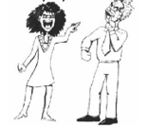
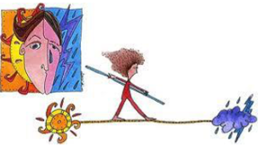
2
emotional and cognitive aspects of sexuality
type of menopause (natural or surgical)
achievement of reproductive goals, education, body image, and self-esteem

Slide 9
Organic-metabolic
Couples dynamic
Affective-cognitive
Age- related changes in midlife

Slide 10
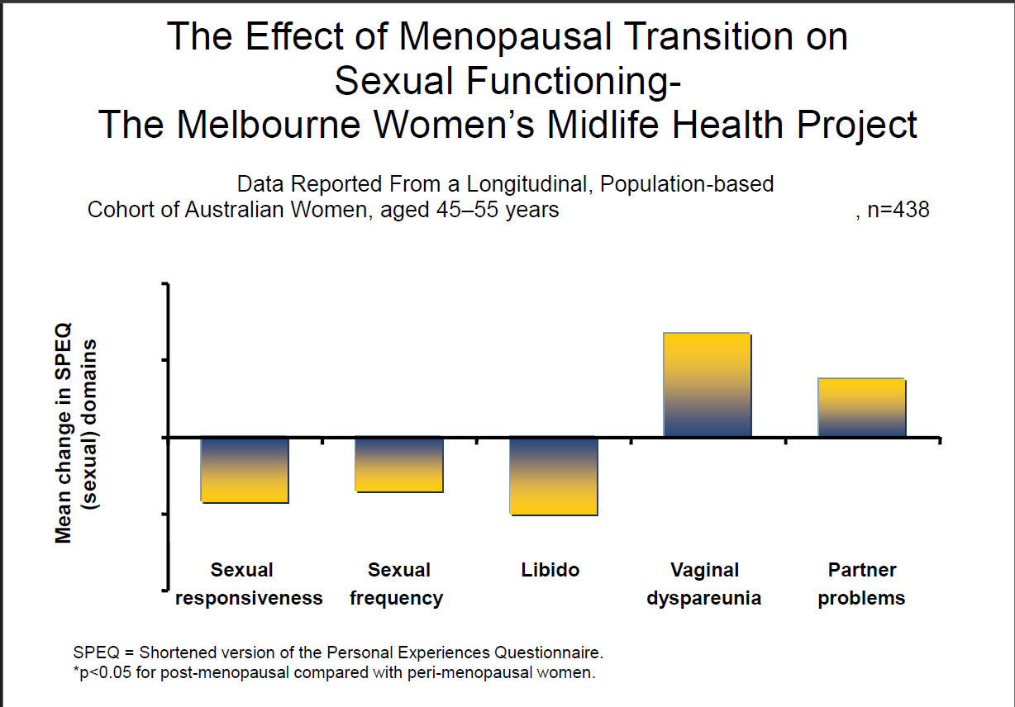

Slide 11
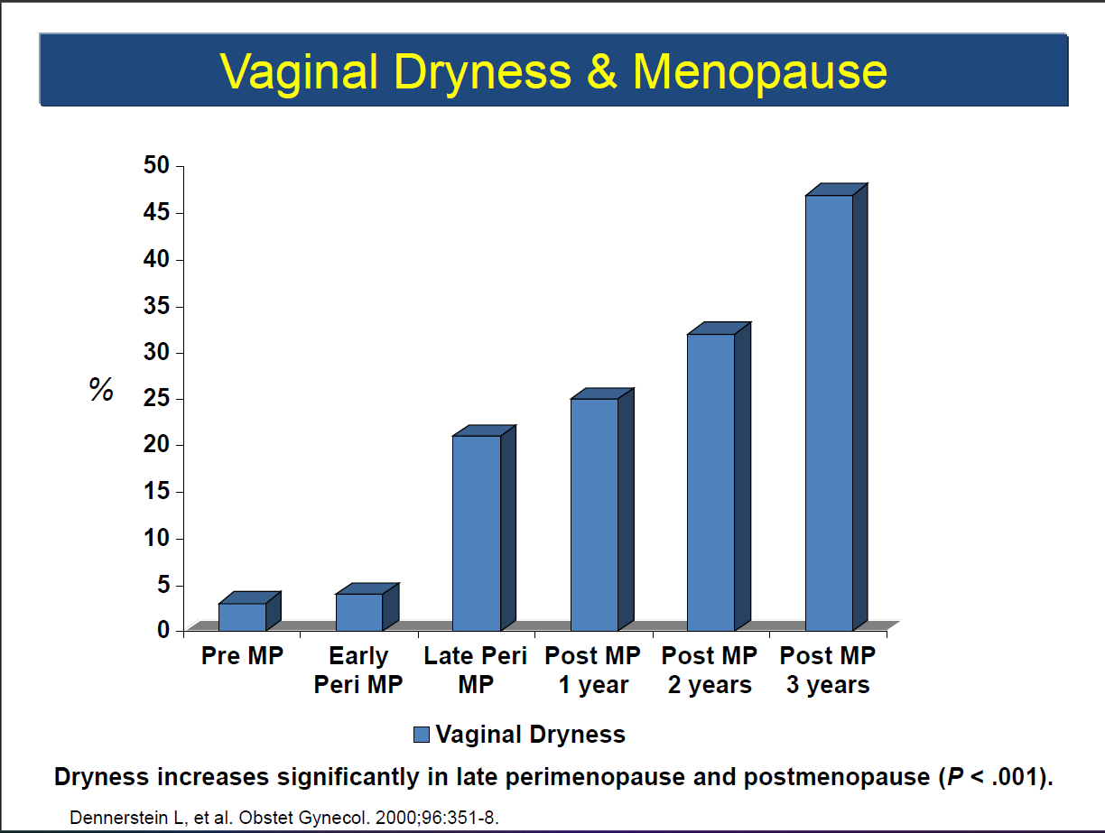

Slide 12
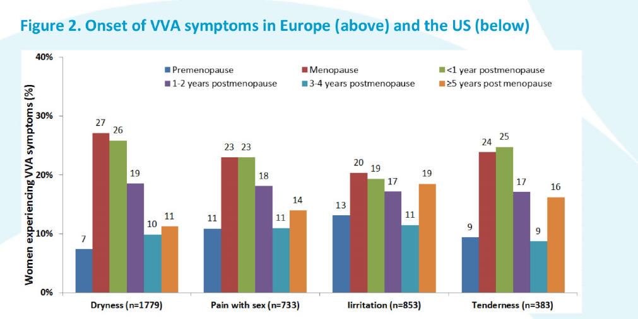

Slide 13
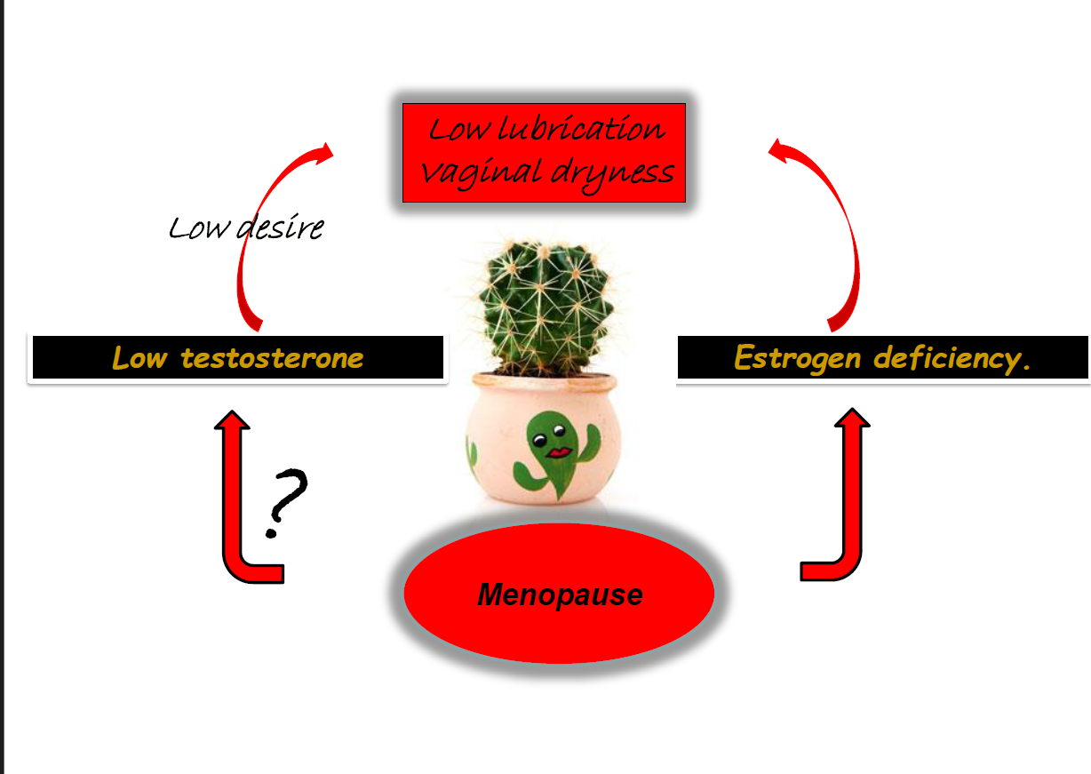

Slide 16
Basic questions:
Are you sexually active?
Any sexual problem :pain ,dryness ,difficulty getting aroused ,sexual desire ,satisfaction ,orgasm
Any sexual problem in spouse
Many problems in postmenopausal women are due to PE/ ED

Slide 17
Medical exam
Full pelvic examination
Ultrasound
External genital exam
Pain trigger point
Pelvic floor
Vaginal PH
Lab test(TSH/FBS/Iron/D3/FSH/LH/Prolactin)
Total testosterone/SHBG/Free T(for T therapy)
Others as indicated

Slide 18
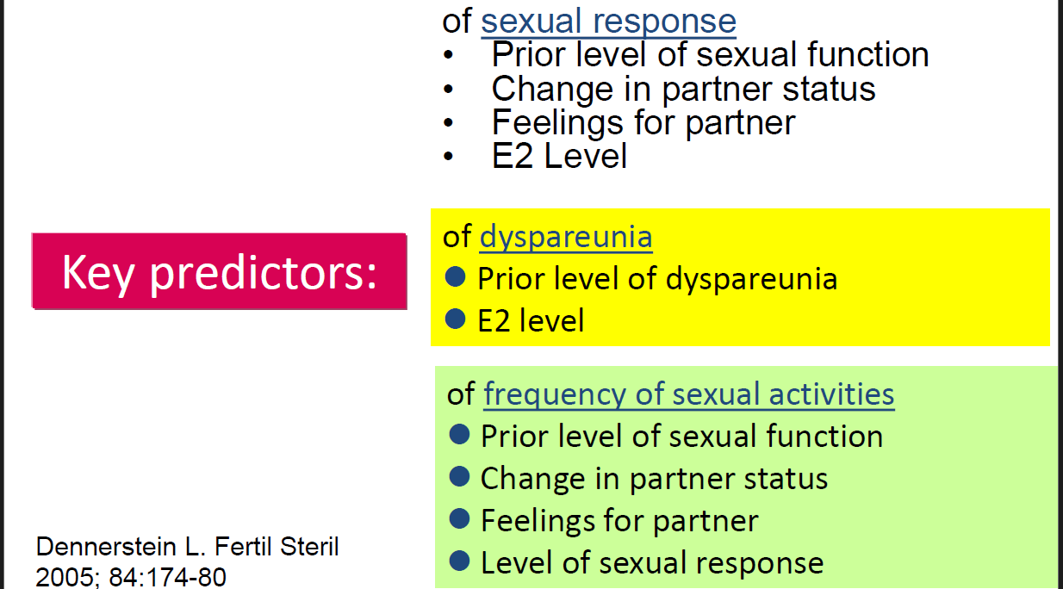

Slide 19
Treatment

Slide 21
Estrogen therapy
VVA/GSM is natural sign of aging, has significant biological, psychological and social consequences.
Systemic Est
Local Est
current low dose therapies are effective & FDA-approved Result in
minimal systemic absorption in local E
long-term safety without medical risk or endometrial stimulation.

Slide 22
Androgens
Testosterone preparations:
IM
subcutaneous implants
transdermal testosterone patches
oral formulations
often in combination with estrogen therapies
systemic T: Increase libido
Vaginal T: Decrease vulvovaginal atrophy

Slide 23
There is no testosterone level for diagnosis of HSDD or for use as a treatment target.
Total testosterone concentration is the best practical assay.
Total testosterone and SHBG should be measured before initiating therapy.
Proper dosing should attain and maintain total testosterone levels in the premenopausal physiological range.

Slide 24
Compounded testosterone, pellets, IM injections ,oral formulations are not recommended.
Additional testing and alternative strategies may be required to assess failure to respond to typical testosterone treatment, particularly when testosterone or SHBG levels are high
If an approved female formulation is not available, one-tenth of a standard male dose can usually achieve the normal premenopausal physiological range.

Slide 25
Contraindication
signs of clinical androgen excess (acne, hirsutism, androgenic alopecia)
using an antiandrogenic medication (finasteride, dutasteride).
hormone-dependent neoplasia should only be recommended in consultation with oncologist
Women with a high SHBG concentration are less likely to experience treatment benefit

Slide 26
DHEA: production declines with increasing age
low levels of DHEA associate with low desire
Oral DHEA not recommended for HSDD in postmenopausal women with normal adrenal function
vaginal DHEA (FDA approved) only effective for dyspareunia because of vulvovaginal atrophy.

Slide 27
Tibolone
Synthetic steroid :selective tissue estrogenic activity regulator
As an estrogen , androgen and progesterone in multiple tissues
Treating mood and sexual desire
Long term safety ???
Previous breast cancer
Women over 60 y(Increased risk of stroke)

Slide 28
Psychosocial therapy
Basic counselling :
physiologic and psychologic change
Couple relationship
Change in desire
Psychosexual management
Behavioral T
Psychosexual therapy
Couple T

Slide 29
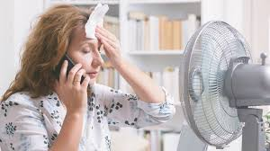
Neurokinin 3 (NK3) receptor signalling play a key role in positive and negative feedback loops regulating the hypothalamic-pituitary-gonadal (HPG) axis. the absence of estrogen greater proportion of the brain chemical neurokinin 3 (NK3) trigger a disruption in the brain's ability to regulate body temperature.
Hot Flash

Slide 30
Other non hormonal drug
SSRI
SNRI
Clonidine
Herbal products can affect physical and sexual state

Slide 31
Targeting KNDY Neurons
Fezolinetant Neurokinin 3 receptor antagonists
New treatment/ non-hormonal therapies for the treatment of vasomotor symptoms in menopausal women
Thermoregulation (4-12 week)
FDA approved: 2024

Slide 32
Premature Ovarian Insufficiency and Early Menopause
Menopausal hormone therapy (MHT) is strongly recommended for early menopause, at least until the age of natural menopause
relieving symptoms
preventing long-term medical conditions.
Physiological replacement of estrogen (and progesterone if the uterus is intact)
The controversies surrounding the use of MHT concerning benefits and risks should not apply to the premature and early menopause population

Slide 33
Myths about sexuality

Slide 35
Meno-pause
Is not Sex-pause
No upper age limit for sexual activity

Slide 36
Pelvic organ prolapse and Sexual Function

Slide 37
Prevalence FSD in POP : 25-63%
The higher stage POP (regardless of vaginal topography but dependent body image)
Correlation between SF/pelvic floor disorder
Higher score in POP:
decreased arousal
Infrequent orgasm
Increased dyspareunia(due to body image and self steam more than change in anatomy)

Slide 38
No correlation with vaginal dimension and sexual activity or SF
Associated factor
menopause(deceased sexual interest/arousal)
low lubrication
low androgen: low desire/genital sensation/ responsiveness
Depression , social factor

Slide 39
Effect of surgery of pop surgical
Dissection tissue damage ,devascularisation ,denervation
Decreased vaginal blood flow and fibrosis
Mesh dyspareunia, tissue contracture ,mesh erosion
Attention
Patient selection specially in
pelvic floor dysfunction(muscle spasm ,trigger point, interstitial cystitis)
Vulvodynia
Chronic constipation
Obstructive lower urinary tract syndrome
This patients maybe has more complication and less satisfaction especially in Coitus UI

Slide 40
Prevalence of urinary Incontinence : 43-45%
Sexual dysfunction:
29% in SI
71% in UI
MUI(mixed)lower quality of life(QOL)

Slide 41
UI & FSD
Direct affect
Desire
Lubrication
Orgasm , Sexual satisfaction
Indirectly
Dermatitis and vulvar irritation
Dyspareunia
Fear engaging in sexual activity

Slide 42
34% : HSDD
23% : Arousal disorder
11% : orgasmic deficiency
7% : Lower desire , lubrication , sexual satisfaction

Slide 43
Prevalence Coitus urinary incontinence (CUI) :10-27%
During in orgasm related to Detrusor over activity
During penetration or thrust related to SI
More effect On QOL

Slide 44
Treatment
Biofeedback
Functional electrical stimulation
Pelvic floor muscle exercise
Vaginal cones
Energy base devices
Pelvic Rehabilitation Program(PRP)

Slide 45
Behavioral treatment:
Empting bladder before sexual activity
Avoid ingestion fluid one hour before love making
Intercourse at female recumbent position(decreasing prolapse pressure and leakage)
Water base lubricant/vaginal estrogen(decreased trauma)

Slide 46
Treatment pain after urogynecological surgery
Analgesics
Anti inflammatory drugs
Muscle relaxant
Local anesthetics injection
Nerve block
Steroid injection at trigger point
Trans vaginal injection of BOTOX
Successful surgery and improvement SF : pre-existing behavioral- emotive and partner related factors

Slide 47
The role of cervix in sexual function is unclear and controversy
Important to consider both urinary and sexual health concerns
Sexual counselling skills
Be empathy the effects Of POP on sexual life as well as overall quality of life
View of her self , embarrassing ,relationship with partner
Describe all available treatment(surgical and non surgical)
Follow patient for improvement

Slide 48
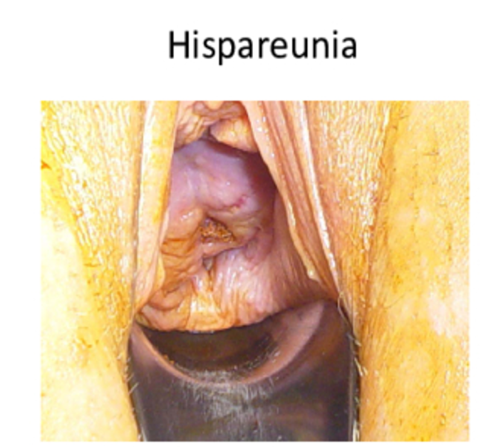
hispareunia
Partner dyspareunia

