Slide 1
Urinary Symptoms of BPH
MAHDI RAMEZANI

Slide 2
The term benign prostatic hyperplasia (BPH) has been historically used to define a disease characterized by symptoms of urinary dysfunction as a consequence of an obstacle to micturition caused by an enlarged prostate.
During recent decades, the acronym LUTS (i.e., lower urinary tract symptoms) has been introduced as an umbrella term to define a complex of symptoms involving dysfunction of both the storage phase and the voiding phase of micturition.

Slide 3
LUTS are considered as a clinical manifestation with a multifactorial pathophysiology arising from different conditions including:
    bladder outlet obstruction (BOO) possibly caused by benign prostatic obstruction (BPO), associated with benign prostatic enlargement (BPE), and potentially resulting from the histologic condition of BPH.
However, LUTS may also be the expression of non-prostatic conditions, such as :
    bladder dysfunction (e.g., detrusor overactivity [DO] or detrusor underactivity [DUA]), urethral strictures, or urinary tract infections (UTIs).

Slide 4
BPH is nearly ubiquitous in the aging male with worldwide autopsy proven histological prevalence increases starting at age 40-45 years to reach 60% at age 60 and 80% at age 80.
The onset of the enlargement is highly variable as is the growth rate, and not all men with BPH will develop any evidence of BPE.
It is important to realize that not all men with BPE will develop obstruction or BPO, just as not all men with BPH will have BPE.

Slide 5
Most elderly men have at least one LUTS .
Lower urinary tract symptoms can progress dynamically: for some individuals LUTS persist and progress over long time periods, and for others they remit .
Lower urinary tract symptoms have traditionally been related to bladder outlet obstruction (BOO), most frequently when histological BPH progresses through benign prostatic enlargement (BPE) to BPO.

Slide 6
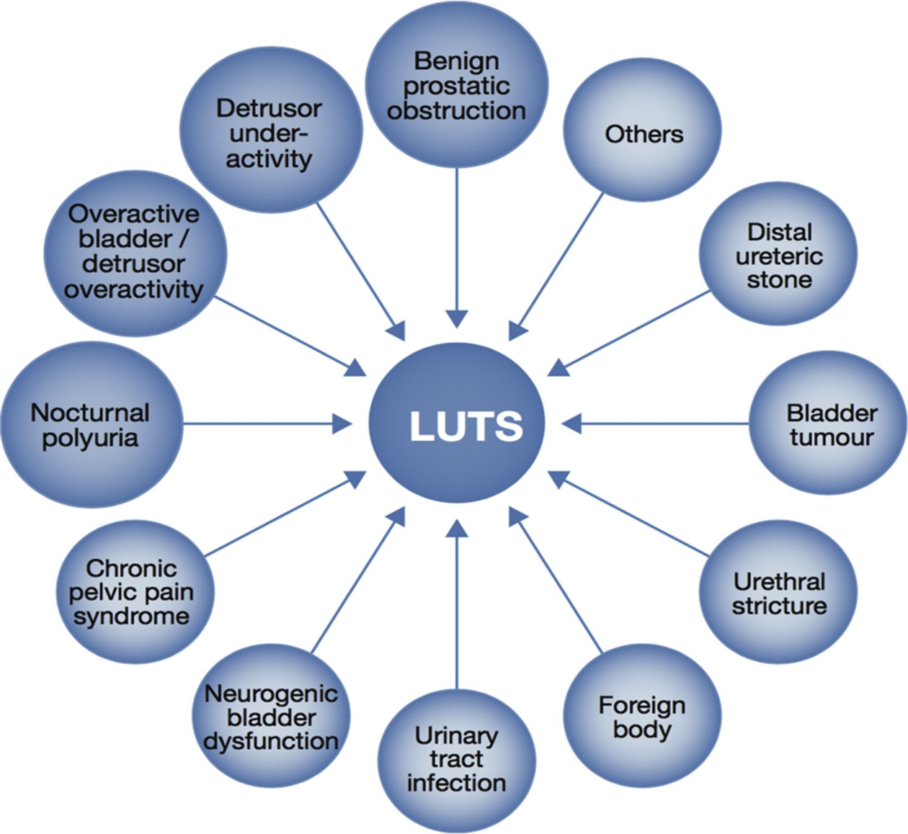
Causes of male LUTS
In any man complaining of LUTS, it is common for more than
one of these factors to be present.

Slide 7
Parallel to these anatomical and functional processes, LUTS increase in frequency and severity with age and are divided into those associated with storage of urine, and/or with voiding or emptying and post-micturition symptoms.
The enlarged gland has been proposed to contribute to the male LUTS complex via at least two routes:
  1. Direct BOO/BPO from enlarged tissue (static component)
  2. Increased smooth muscle tone and resistance within the enlarged gland (dynamic component)
    This complex of storage symptoms is often referred to as overactive bladder (OAB). In men, OAB may be the result of primary detrusor over activity (DO)/underactivity, or secondary to the obstruction induced by BPE and BPO.

Slide 8
It is important to recognize that LUTS are non-specific, occur in men and women with similar frequency and may be caused by many conditions, including BPE and BPO.
Because BPH is nearly ubiquitous and because LUTS in men is commonly associated with and/or caused by BPE/BPO, a compromise terminology is often used referring to “LUTS most likely associated with BPE/BPO and BPH” or “LUTS secondary to BPH.”

Slide 9
Progressive increase in the prevalence of moderate-to severe LUTS, rising to nearly 50% by the eighth decade of life.
The presence of moderate-to-severe LUTS was also associated with the development of AUR as a symptom of BPH progression, increasing from an incidence of 6.8 episodes per 1,000 patient years of follow-up in the overall population to a high of 34.7 episodes in men aged 70 and older with moderate-to severe LUTS.
In addition, men with moderate-to-severe LUTS may have an increased risk of major adverse cardiac events.

Slide 10
Another study has estimated that 90% of men between 45 and 80 years of age suffer some type of LUTS. however, symptoms are often mild or not very bothersome.
Although LUTS/BPH is not often a life threatening condition, the impact of LUTS/BPH on QoL can be significant and should not be underestimated.
The IPSS, a validated self administered questionnaire, can provide clinicians with information regarding the symptom burden patients are experiencing.

Slide 11
