Slide 1

Report of the Iranian Neonatal Registry: A Pilot Study
Golnaz Rezaeizadeh MD

Slide 2

Goal: Improving the effectiveness and efficiency of medical care for newborn infants and their families through a coordinated program of research, education, and quality improvement projects
Vermont Oxford Network was established
1989

Slide 3
36 hospitals submitted data for about 3000 very low birth weight infants
The first full year of database operations
1990

Slide 4
1998
More than 300 NICUs submitted data in Vermont Oxford Network

Slide 5

The Iranian Ministry of Health and Medical Education ordered the Maternal, Fetal, and Neonatal Research Center to build up a neonatal registry network system in order to improve the existing knowledge on the status of neonatal health and also the quality of neonatal care in Iran
2011

Slide 6
2013
On March 1, 2013, the Iranian Neonatal Registry was first established in Vali-Asr Hospital.

Slide 7
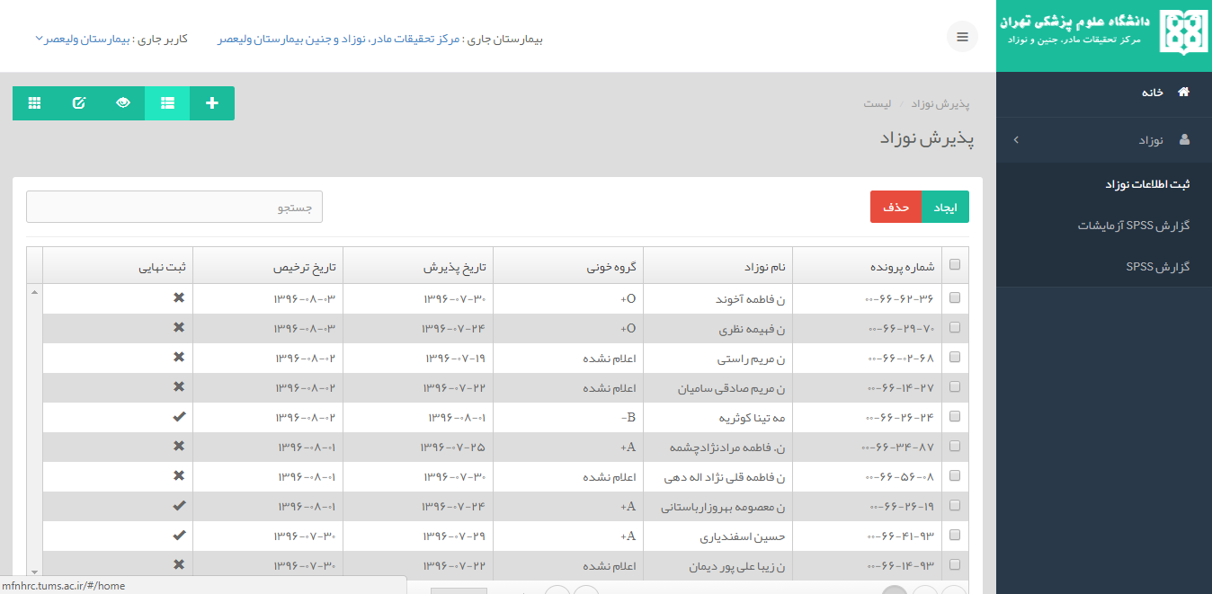
SUCCESS

Slide 8
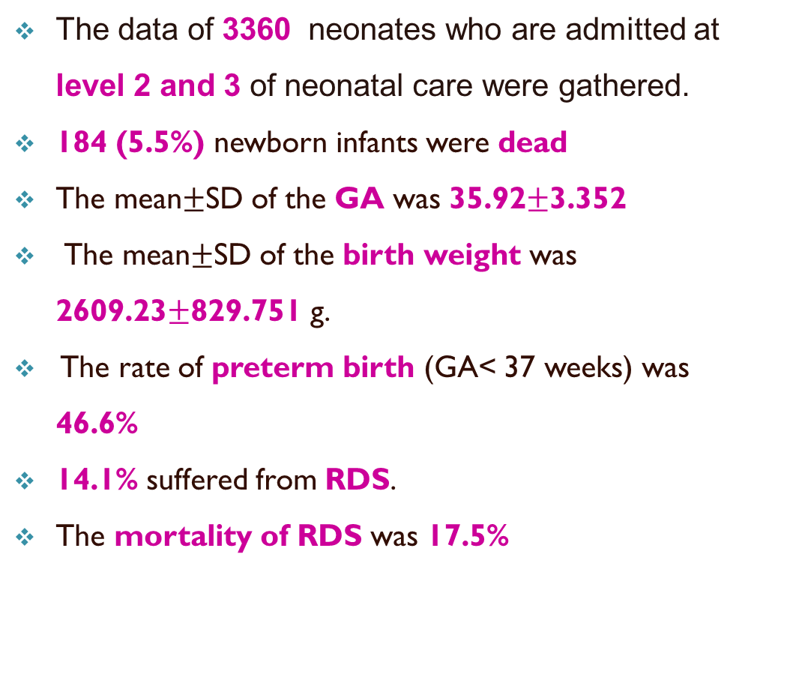
The data of 3360 neonates who are admitted at level 2 and 3 of neonatal care were gathered.
184 (5.5%) newborn infants were dead
The mean$±$SD of the GA was 35.92$±$3.352
The mean$±$SD of the birth weight was 2609.23$±$829.751 g.
The rate of preterm birth (GA< 37 weeks) was 46.6%
14.1% suffered from RDS.
The mortality of RDS was 17.5%
2013-2016

Slide 9
2017
Neonatal Registery System connection established with HIS

Slide 10
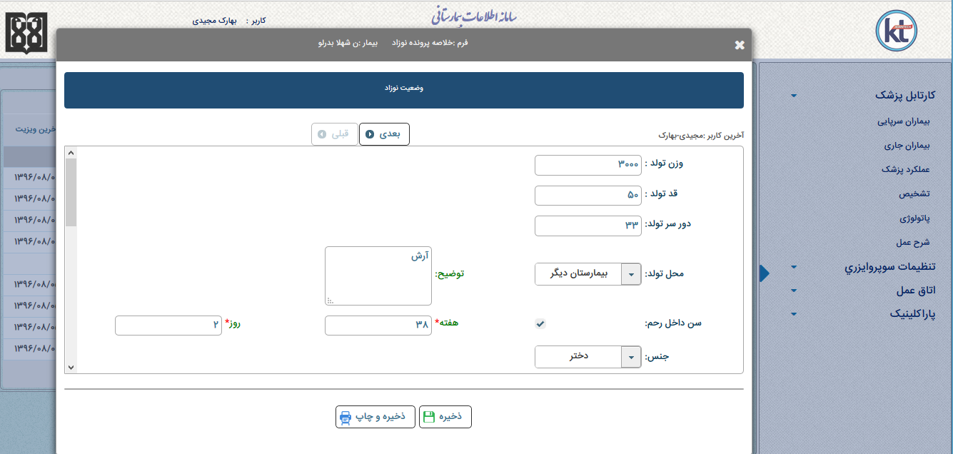
Designing the physician inbox in HIS system

Slide 11

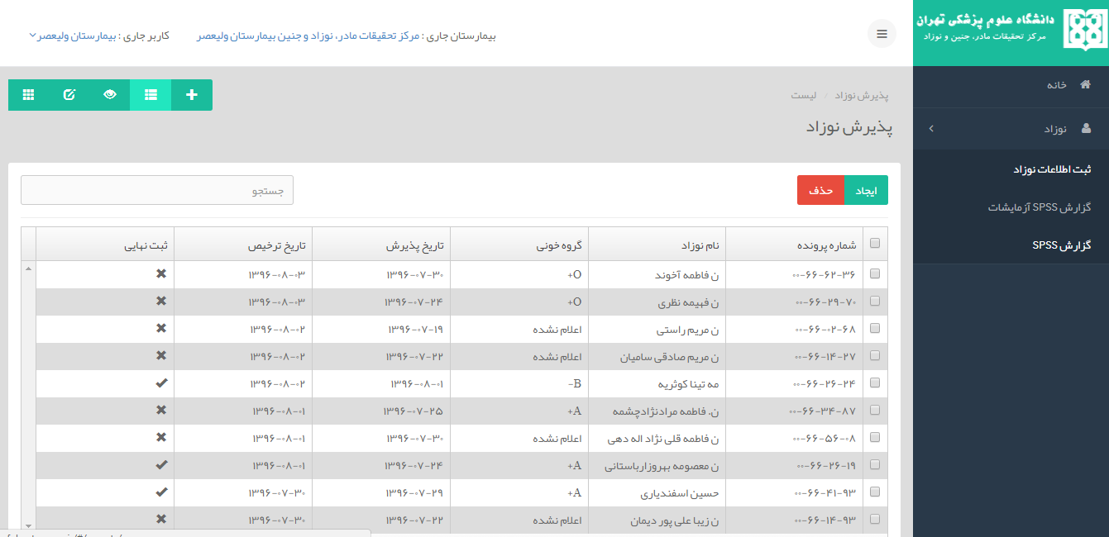

Slide 12
Connect to Lab.

Slide 13
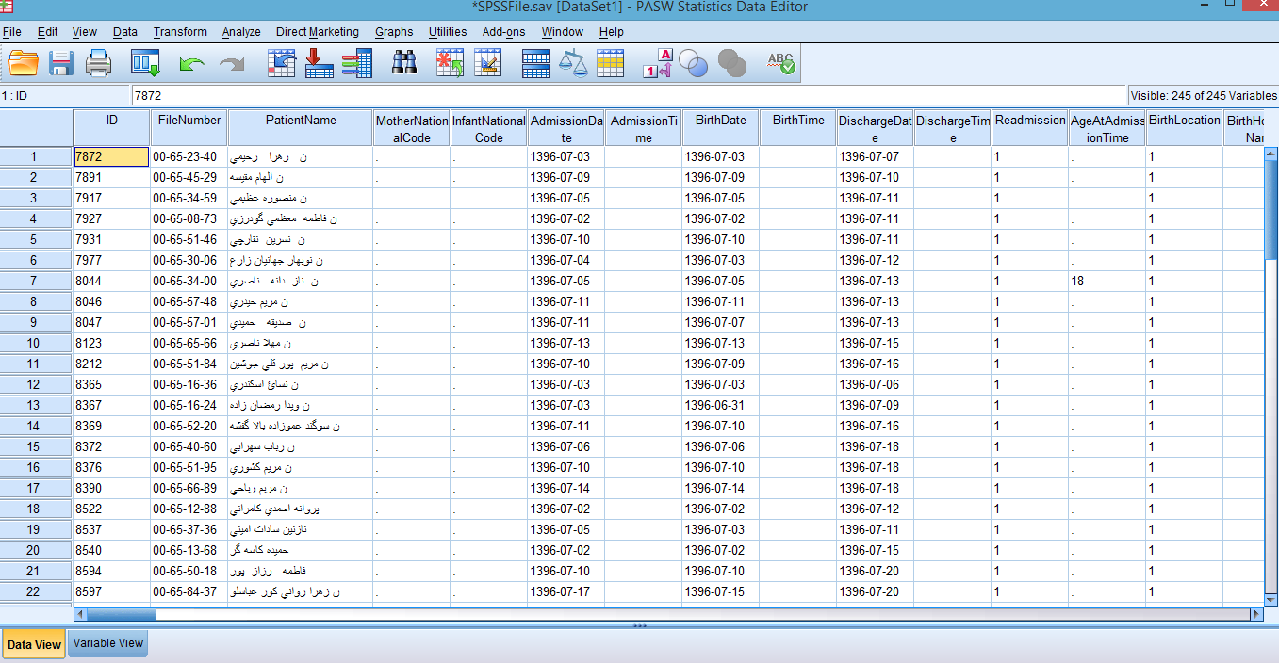
SPSS

Slide 14
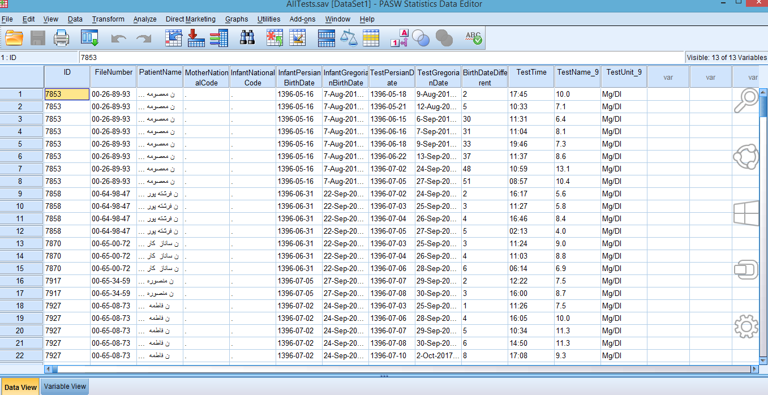
LAB. SPSS

Slide 15
Future?

